Slide 1

URBAN PULSE
Smart Urban Mobility & Traffic Intelligence
Infosys _Smart Urban Mobility and Traffic Intelligence Dashboard Group 1
Bengaluru • Multimodal Analytics • ETL • MySQL • Power BI
DATA
WAREHUSE
ANALYTICS
DECISIONS

Slide 2
Team Roles & Technology Stack
2
Clear ownership across engineering, analytics and BI.
Abhishek Yadav
Afsha Shaik
Data Engineer ETL • Data Warehouse
Geospatial Analyst Maps • spatial analysis • coverage
Ansh Patidar
Anubha Mittal
Transit & Ride-Hailing Analyst Transit performance • demand intelligence
Micromobility & Equity Analyst Cycling • MAI • accessibility
Bysani Sree Lalitha
All Team
BI Lead / Project Manager Dashboard integration • coordination
Cross-functional Validation • testing • final delivery
Python
Pandas
APIs
MySQL
Power BI
Group 1

Slide 3
Project Vision & Problem
03
One analytics environment for understanding how Bengaluru moves.
The challenge
The solution
The outcome
Mobility data is fragmented across transit, ride-hailing, cycling, weather, traffic and demographic sources. Without standardization, cross-modal analysis is difficult.
Urban Pulse integrates multimodal datasets into a common data model, then exposes operational and strategic insights through Power BI.
Stakeholders can monitor demand, reliability, accessibility, mobility equity, bottlenecks and future mobility trends in one place.
Bengaluru • Multimodal • Decision Support
Group 1

Slide 4
Objectives & Key Outcomes
04
What the platform is designed to deliver.
6+
1
MAI
CMHS
mobility data domains
integrated analytics model
mobility equity indicator
city mobility health score
Transit, ride-hailing, bike-sharing, weather, traffic and demographics
Standardized data model for cross-modal analysis
Compare access and identify mobility gaps
Executive-level view of overall mobility performance
• Standardize timestamps, identifiers and schemas through repeatable ETL.
• Create a star-schema warehouse and validated Power BI semantic model.
• Enable geospatial, performance, demand, equity and executive analytics.
• Support forecasting and anomaly detection for future mobility planning.
Group 1

Slide 5
Data Sources & Acquisition
05
Public and open mobility data combined into a unified Bengaluru dataset.
Public Transit
Ride-Hailing
BMTC / GTFS feed Routes • stops • trips • stop times • calendar
Open City / open mobility data Demand • pickup/drop-off • trip-level indicators
Bike Sharing
Weather
Open City / open mobility data Station usage • trip activity • availability
Open-Meteo API Temperature • rainfall • humidity • wind
Traffic
Demographics
Traffic / mobility dataset Traffic volume • congestion indicators
Demographic / census data Population • neighborhood-level indicators
Group 1

Slide 6
ETL & Data-Warehouse Architecture
06
From raw mobility files to a connected Power BI analytics layer.
RAW SOURCES
EXTRACT
TRANSFORM
LOAD
ANALYZE
GTFS • CSV • API
Python + Pandas File/API ingestion
Cleaning • standardization Validation • timestamps
MySQL warehouse Structured tables
Power BI KPIs • maps • trends
Repeatable ETL
Warehouse layer
BI-ready model
Reusable scripts reduce manual CSV handling and support refresh.
MySQL provides a centralized, queryable and joinable source of truth.
Power BI reads the prepared model for interactive analytics.
Group 1

Slide 7
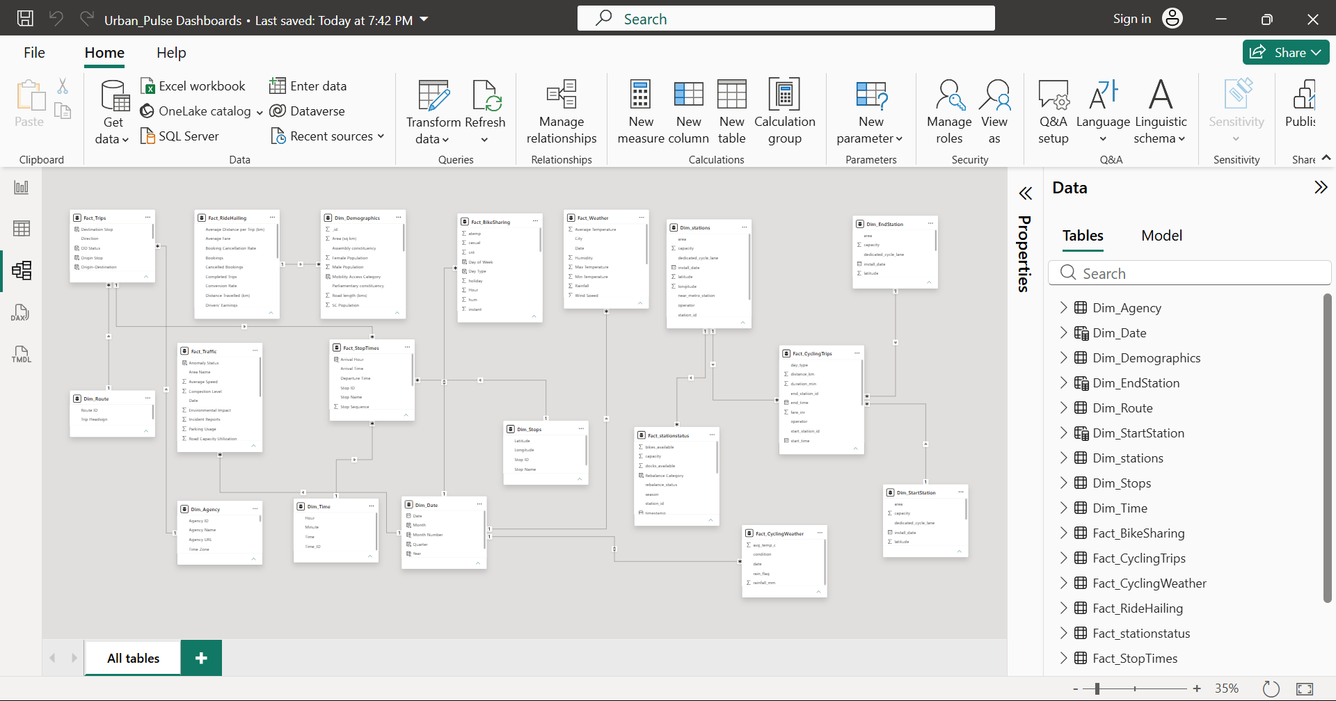
Data Model & Star Schema
07
Fact tables capture mobility events; dimensions provide reusable context.
Group 1

Slide 8
Module 1 — Data Acquisition & Integration
08
Foundation layer: collect, standardize, validate and load.
What this module does
4
9K
Collect mobility data from multiple sources, standardize schemas and timestamps, validate quality, and load the prepared data into MySQL for Power BI.
Data sources
Ride-hailing records
17K
9K
Bike-share records
Transit records
1K
Weather points
Quality checks
Row count • NULL • min/max • relationships
Group 1

Slide 9
Module 2 — Geospatial Mobility Analytics
09
Where mobility happens: coverage, OD flows and hotspots.
What this module does
Use latitude/longitude, wards, stops and routes to understand demand concentration, service coverage, mobility corridors and congestion hotspots.
Illustrative OD / hotspot view
167
136
498
Trips in selected OD
Routes
Stops
Group 1

Slide 10
Module 3 — Transit Performance Analytics
10
How public transit performs.
What this module does
136
498
Measure route reliability, schedule adherence, headway behavior, stop activity and service performance using GTFS trips and stop-time data.
Total routes
Total stops
167
14K
Total trips
Incident reports
Decision value
Identify weak routes • compare route performance • detect service gaps
Group 1

Slide 11
Module 4 — Ride-Hailing & Demand Intelligence
11
Understanding on-demand mobility.
What this module does
59M
37M
22M
Analyze pickup/drop-off demand, time-of-day patterns, fare/surge indicators and the relationship between ride-hailing and public transit.
Total bookings
Completed trips
Cancelled trips
31.37%
132.07
Conversion rate
Average fare
Decision value
Plan capacity around peaks • identify high-demand zones • explore modal substitution
Group 1

Slide 12
Module 5 — Cycling & Micromobility Analytics
12
First/last-mile mobility.
What this module does
89.824K
42
43.7%
Track bike-share utilization and station activity, identify imbalance, and assess how micromobility complements the broader transport network.
Total bike trips
Active stations
Avg. station utilization
9.12
8.78
Avg. available bikes
Avg. trip duration
Decision value
Find high-use stations • flag rebalancing needs • measure micromobility adoption
Group 1

Slide 13
Module 6 — Mobility Equity Analysis
13
Access for every neighborhood.
What this module does
8M
58.94
Calculate the Mobility Access Index (MAI), compare accessibility across geographic and demographic groups, and highlight underserved areas.
Total population
Average MAI score
11.91K
19
Population density
Well-served constituencies
Decision value
Prioritize investment • compare access disparities • support equitable mobility planning
Group 1

Slide 14
Module 7 — Executive Intelligence & Forecasting
14
From insight to action.
What this module does
59M
9K
0.31
Combine city-wide mobility health metrics with historical trends, anomaly detection and forecasting to give decision-makers a concise strategic view.
Total bookings
Total traffic
Conversion rate
39.45
75
Average speed
Mobility Health Score
Historical trend → forecast → anomaly alert
Group 1

Slide 15
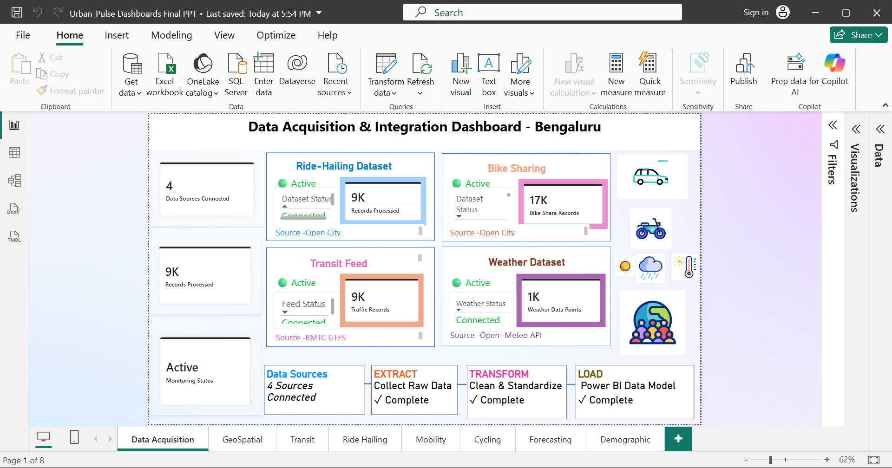
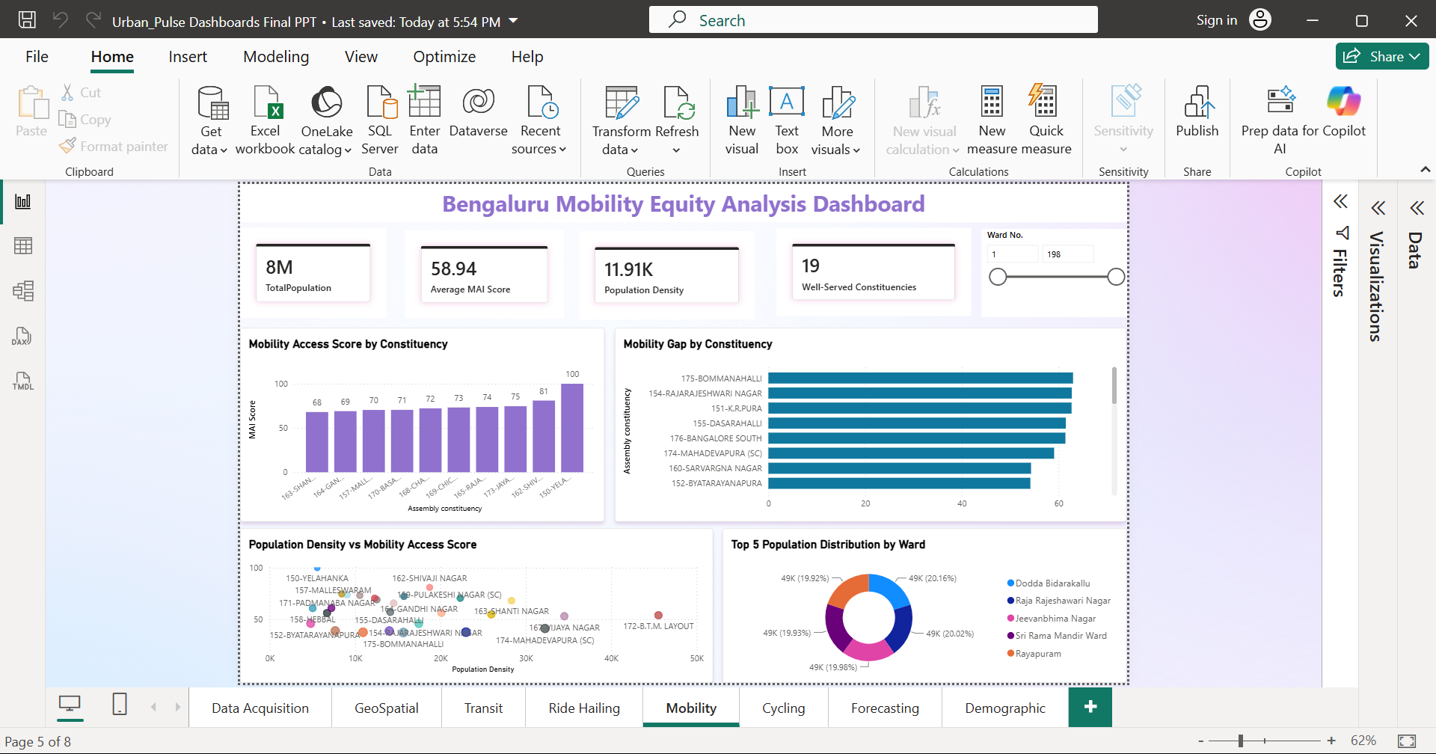
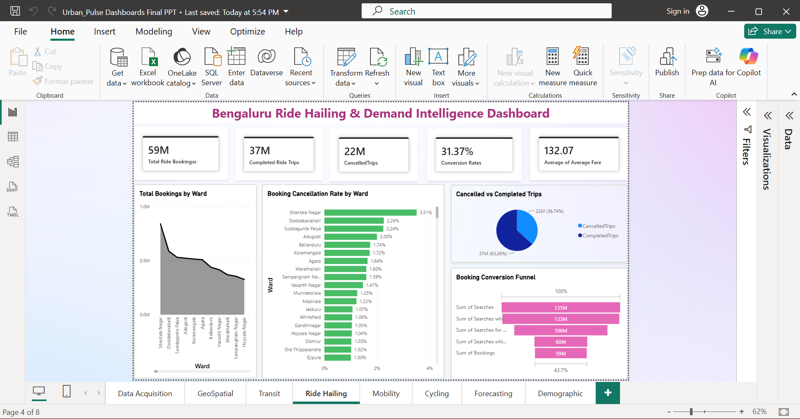
Dashboard Showcase
15
For More Team Github
Thank You
Group 1

